Slide 1
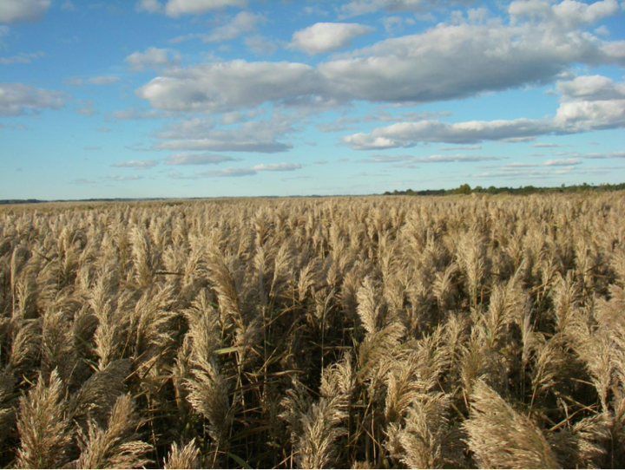

Slide 11
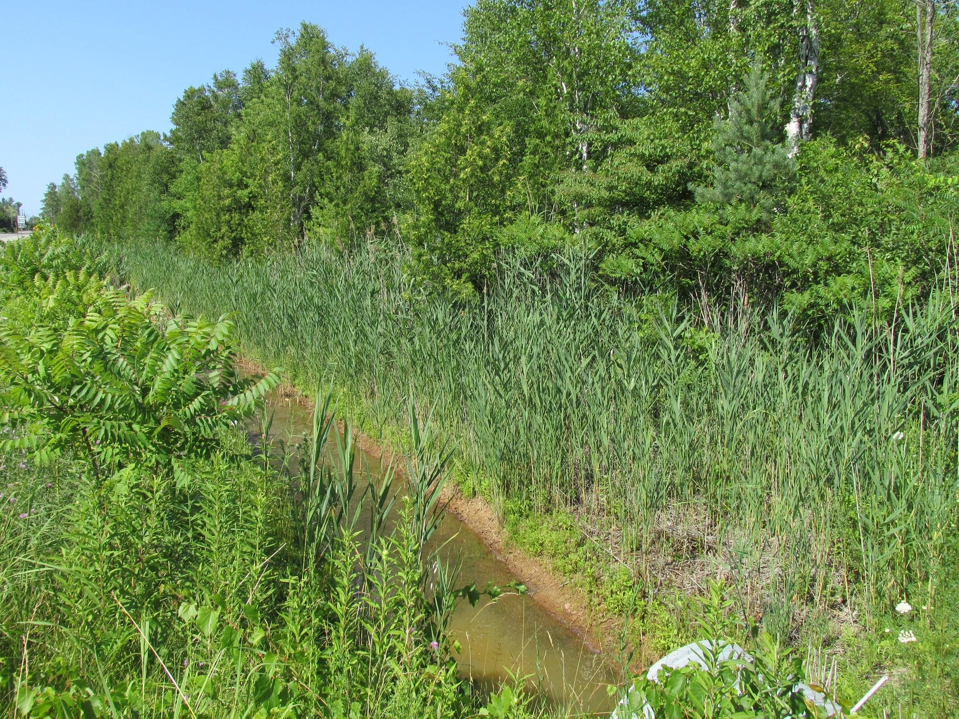
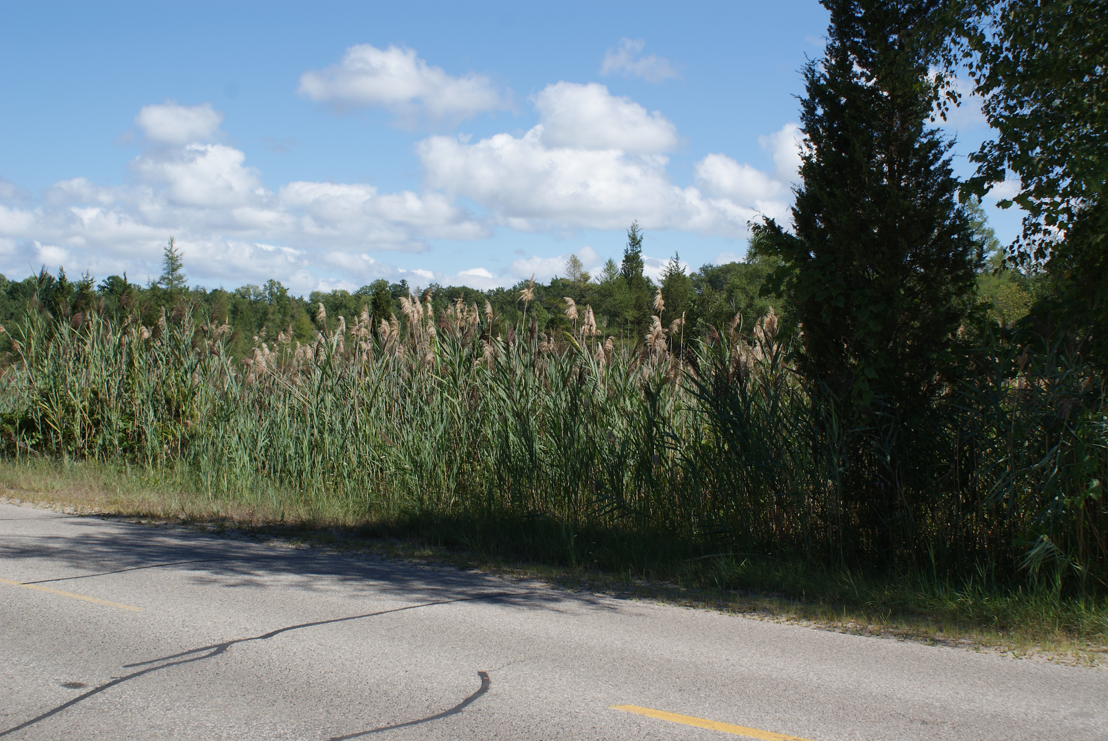
It is found by roadsides and in ditches.
Once you recognize it you’ll notice it in so many places!

Slide 27
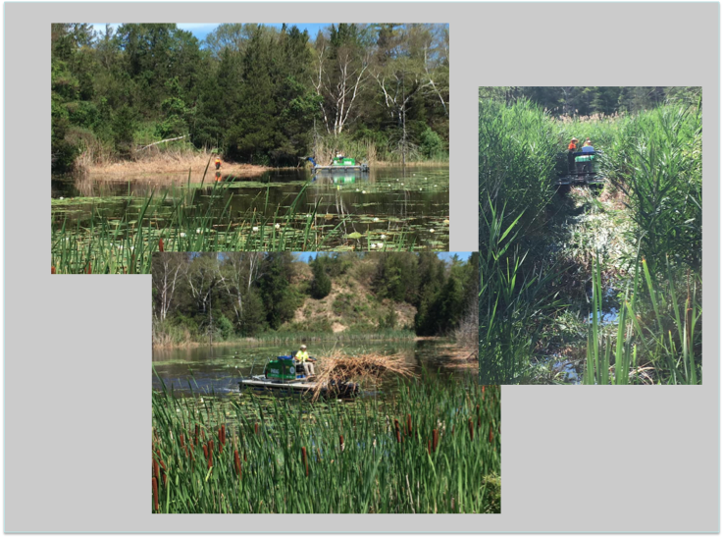

Slide 29
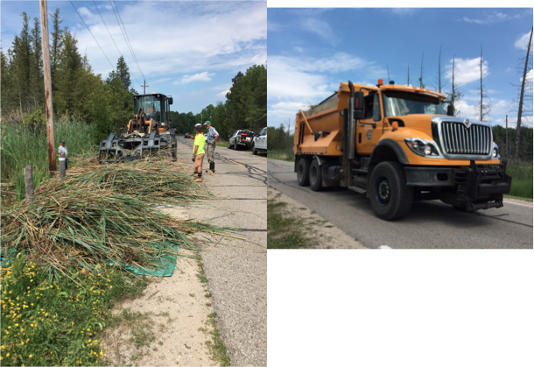
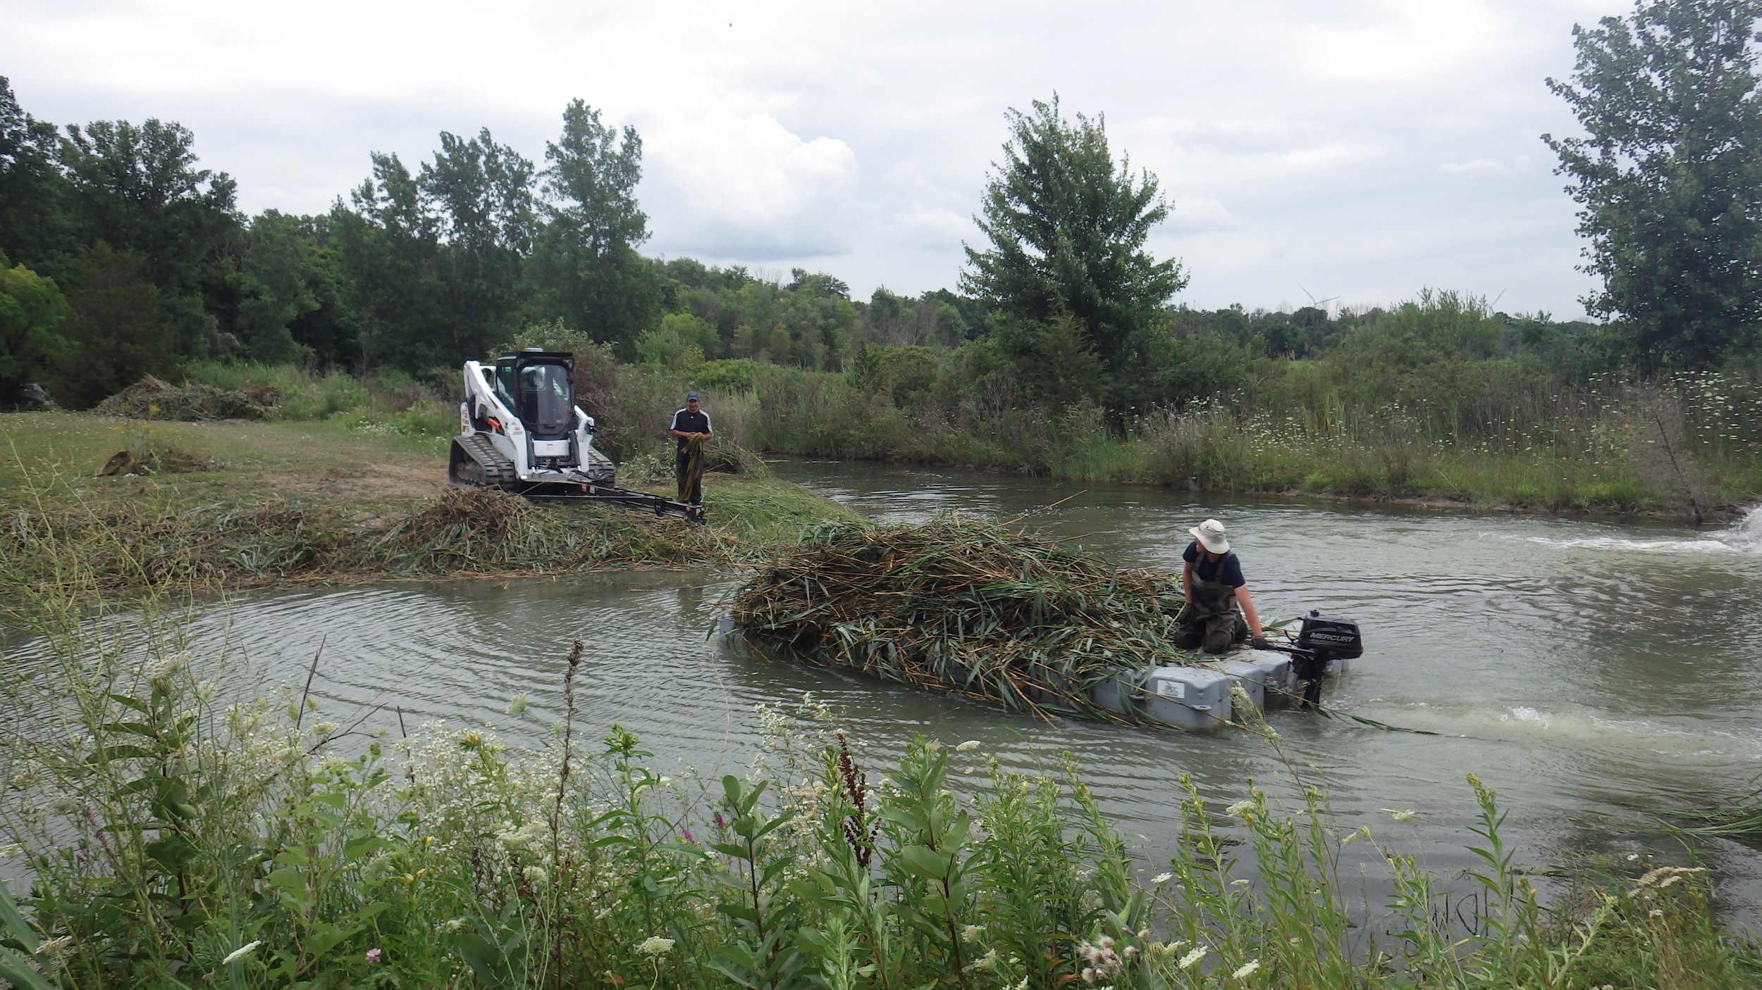

Slide 30
That’s a lot of Phragmites! Good thing they’ve got this heavy machinery to help!

Slide 32
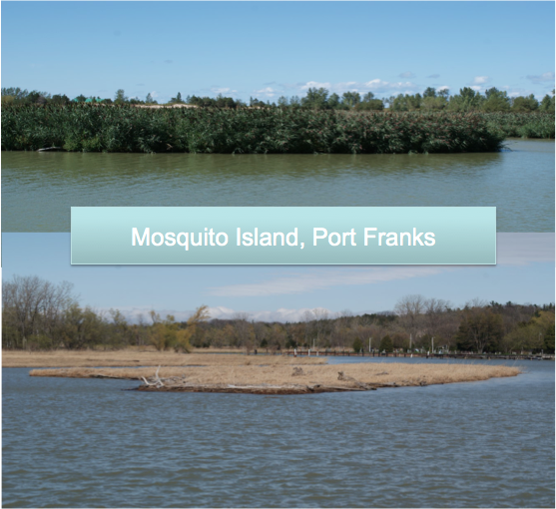

Slide 37
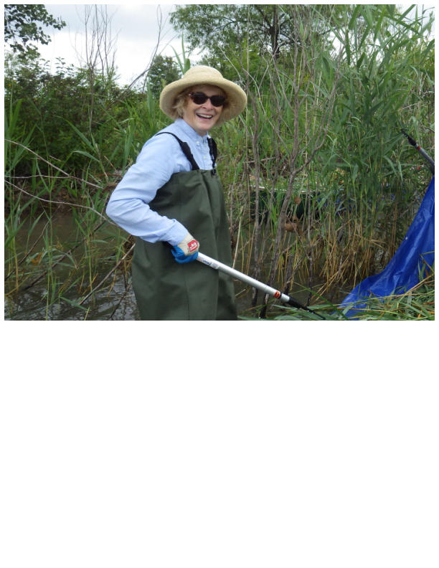
Even one person can make a BIG DIFFERENCE!
Working together in partnership, community organizations and service clubs, conservation authorities, different levels of government and many volunteers can conquer Phragmites!

Slide 38
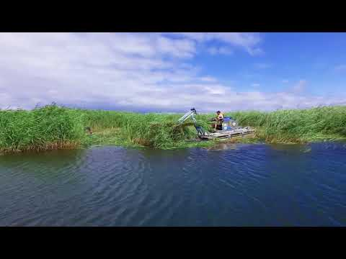
Click on the logos above to navigate to websites with more information!

